Slide 1
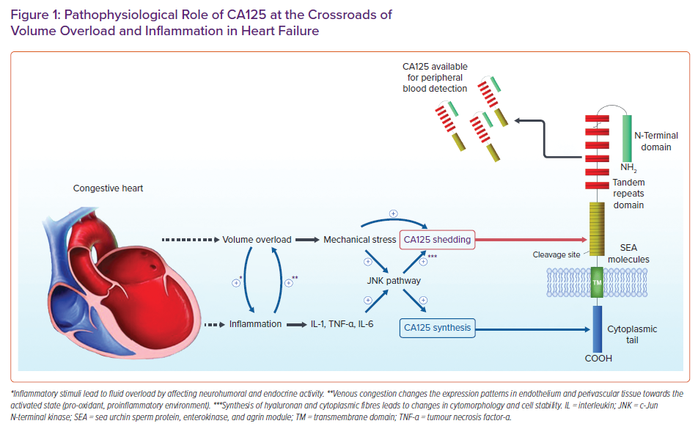
Kumric M, Kurir TT, Bozic J, Glavas D, Saric T, Marcelius B, D'Amario D, Borovac JA
Pathophysiological Role of CA125 at the Crossroads of Volume Overload and Inflammation in Heart Failure
Citation: Cardiac Failure Review 2021;7:e19.
https://doi.org/10.15420/cfr.2021.22

