Slide 1
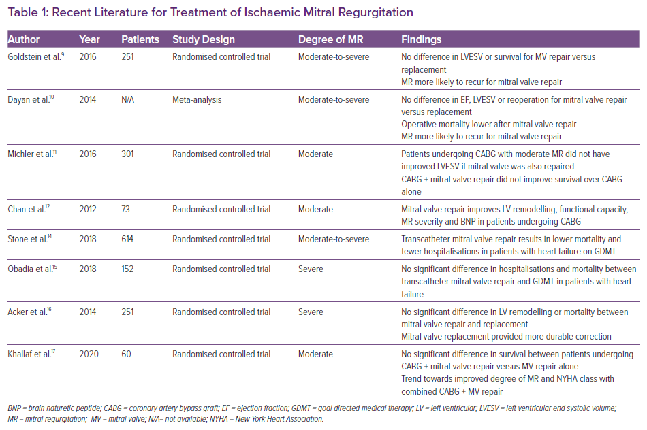
Johannesen SL, Barker CM, Levack MM
Recent Literature for Treatment of Ischaemic Mitral Regurgitation
Citation: Cardiac Failure Review 2021;7:e20.
https://doi.org/10.15420/cfr.2021.06

