Slide 1
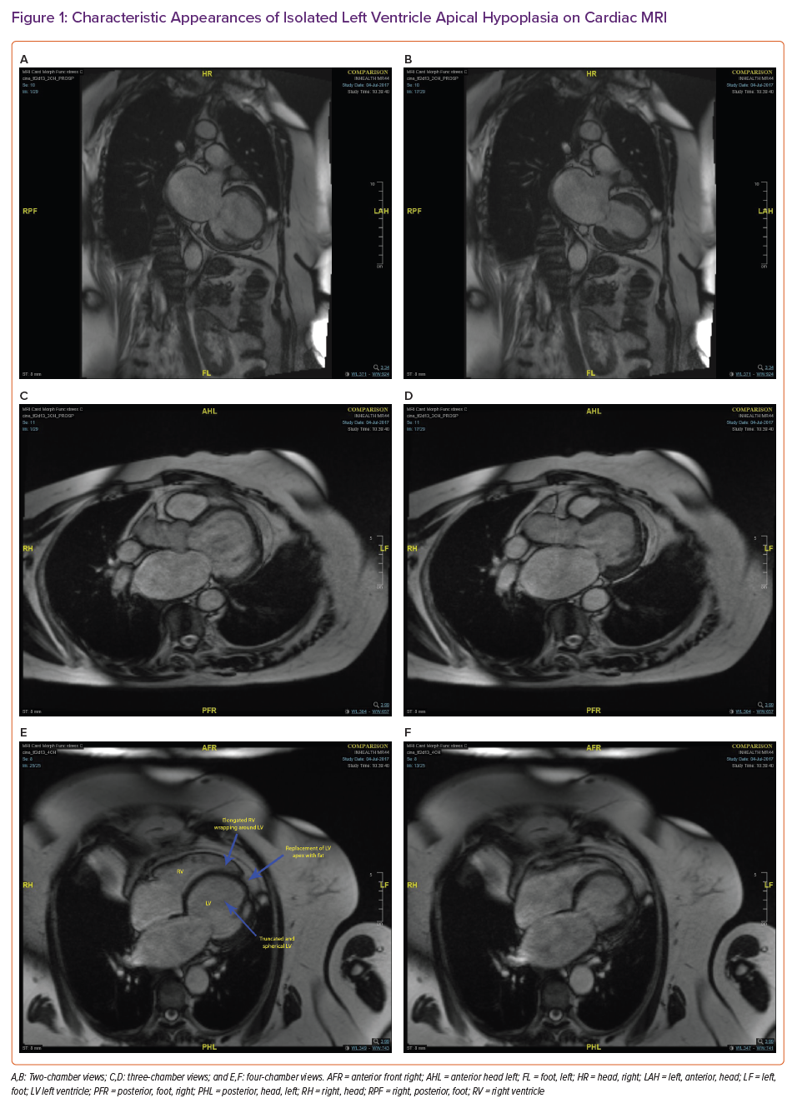
Dattani A, Prasad R
Characteristic Appearances of Isolated Left Ventricle Apical Hypoplasia on Cardiac MRI
Citation: Cardiac Failure Review 2021;7:e21.
https://doi.org/10.15420/cfr.2021.24

