Slide 1
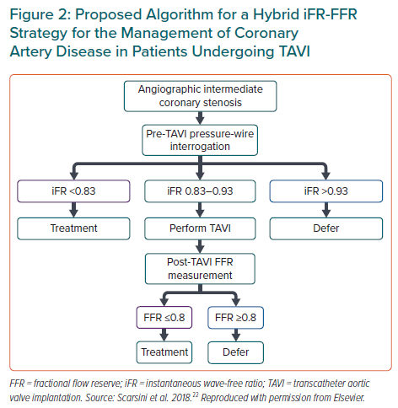
de Azevedo Filho AF, Accorsi TA, Ribeiro HB
Proposed Algorithm for a Hybrid iFR-FFR Strategy for the Management of Coronary Artery Disease in Patients Undergoing TAVI
Citation: European Cardiology Review 2021;16:e49.
https://doi.org/10.15420/ecr.2021.27

