Slide 1
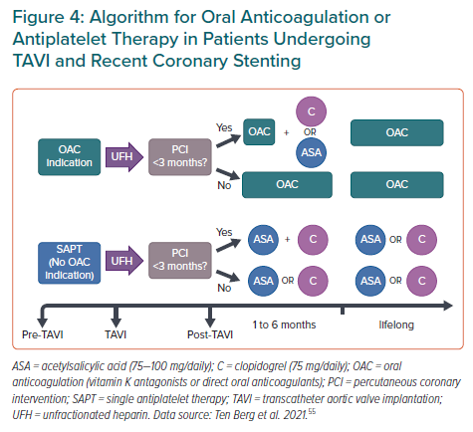
de Azevedo Filho AF, Accorsi TA, Ribeiro HB
Algorithm for Oral Anticoagulation or Antiplatelet Therapy in Patients Undergoing TAVI and Recent Coronary Stenting
Citation: European Cardiology Review 2021;16:e49.
https://doi.org/10.15420/ecr.2021.27

