Slide 1
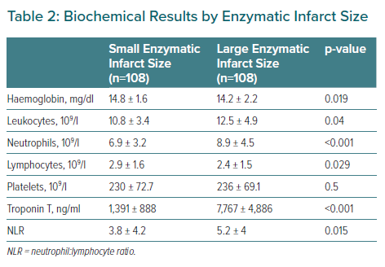
Díaz-Chirón L, Negral L, Megido L, Suárez-Peña B, Domínguez-Rodríguez A, Rodríguez S, Abreu-Gonzalez P, Pascual I, Morís C, Avanzas P
Biochemical Results by Enzymatic Infarct Size
Citation: European Cardiology Review 2021;16:e50.
https://doi.org/10.15420/ecr.2021.37

