Slide 1
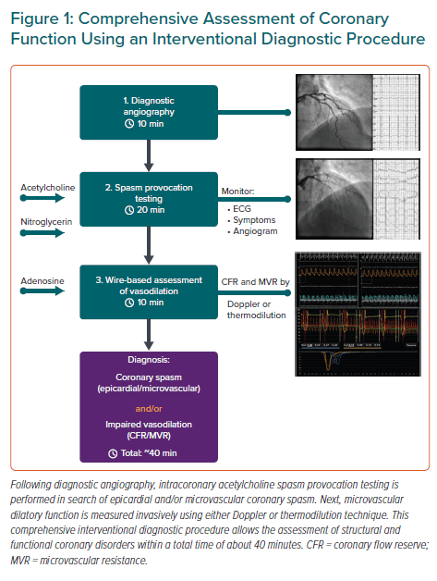
Seitz A, McChord J, Bekeredjian R, Sechtem U, Ong P
Comprehensive Assessment of Coronary Function Using an Interventional Diagnostic Procedure
Citation: European Cardiology Review 2021;16:e51.
https://doi.org/10.15420/ecr.2021.14

