Slide 1
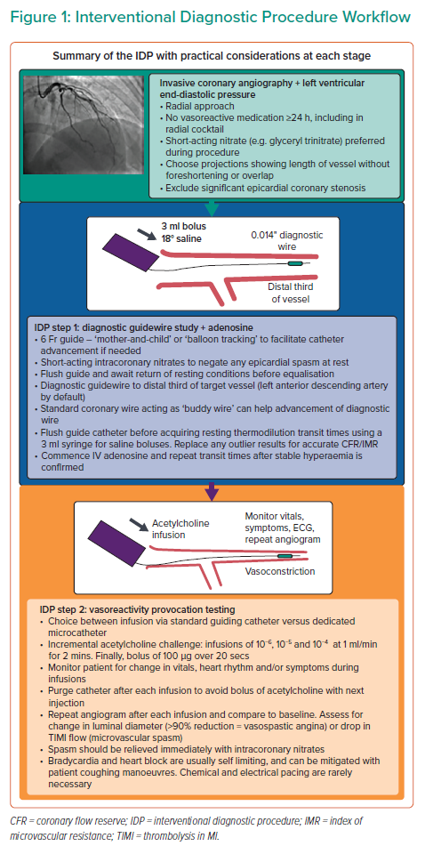
Yee Ang DT, Berry C
Interventional Diagnostic Procedure Workflow
Citation: Interventional Cardiology 2021;16:e32.
https://doi.org/10.15420/icr.2021.16

