Slide 1
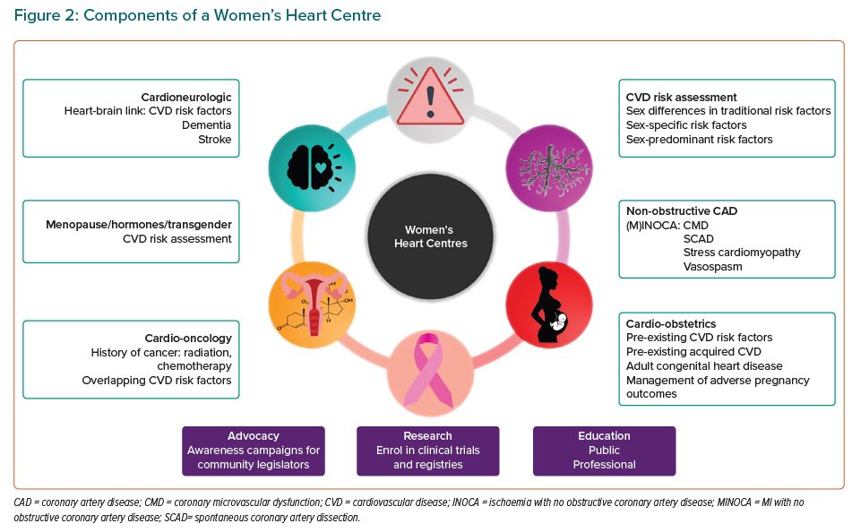
Gulati M, Hendry C, Parapid B, Mulvagh SL
Components of a Women’s Heart Centre
Citation: European Cardiology Review 2021;16:e52.
https://doi.org/10.15420/ecr.2021.49

