Slide 1
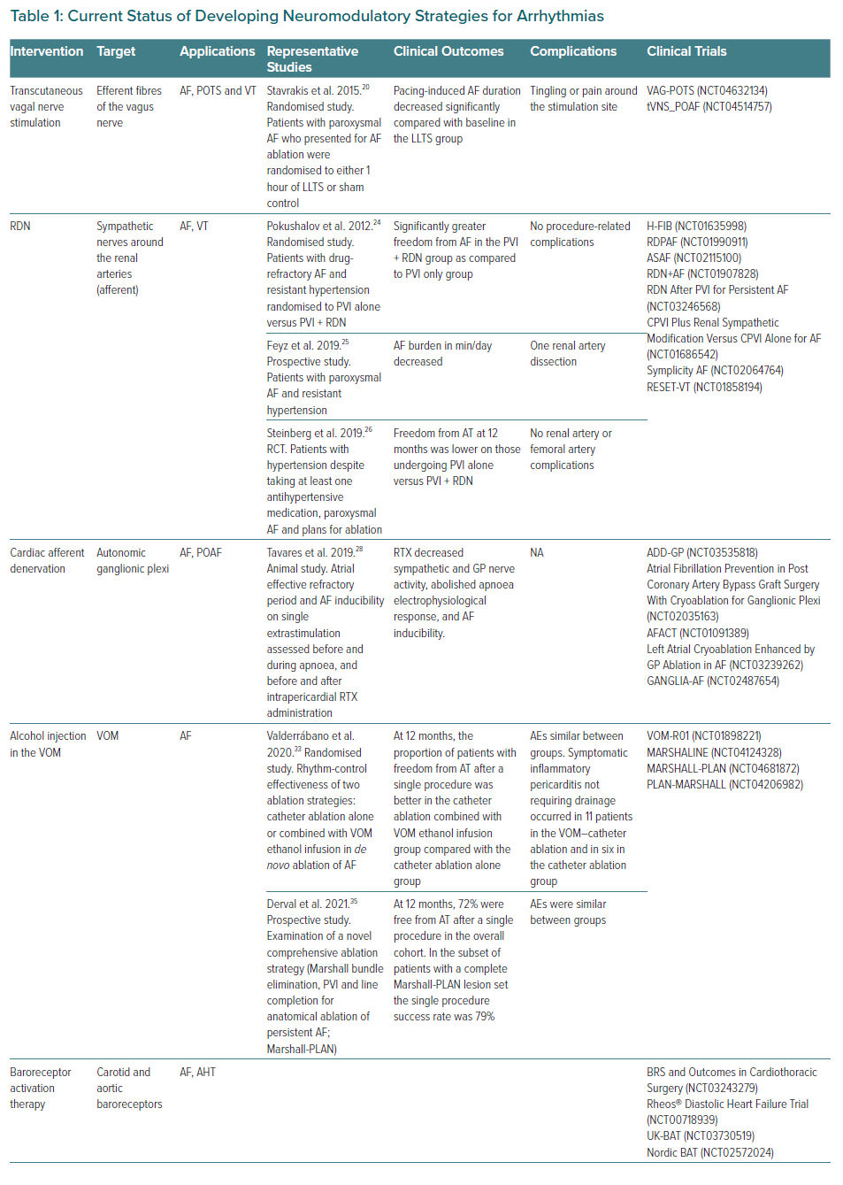
Rodríguez-Mañero M, Martínez-Sande JL, García-Seara J, González-Ferrero T, González Juanatey JR, Schurmann P, Tavares L, Valderrábano M
Current Status of Developing Neuromodulatory Strategies for Arrhythmias
Citation: European Cardiology Review 2021;16:e53.
https://doi.org/10.15420/ecr.2021.05

