Slide 1
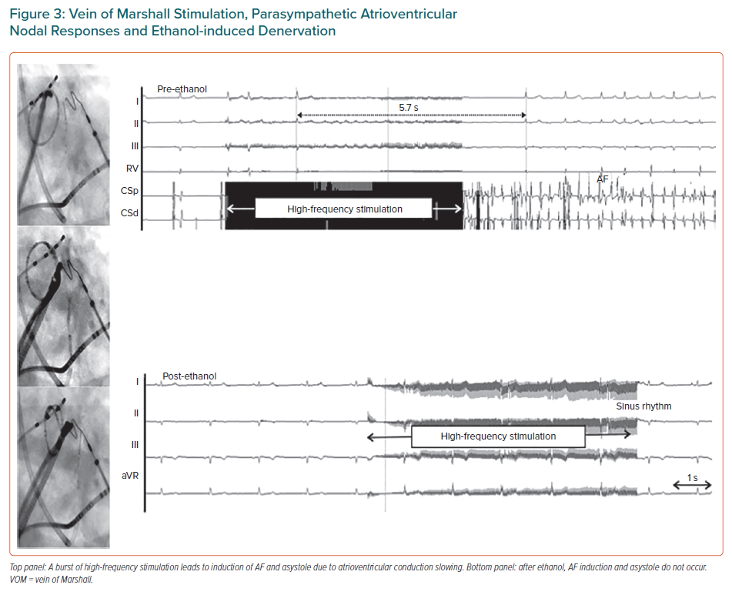
Rodríguez-Mañero M, Martínez-Sande JL, García-Seara J, González-Ferrero T, González Juanatey JR, Schurmann P, Tavares L, Valderrábano M
Vein of Marshall Stimulation, Parasympathetic Atrioventricular Nodal Responses and Ethanol-induced Denervation
Citation: European Cardiology Review 2021;16:e53.
https://doi.org/10.15420/ecr.2021.05

