Slide 1
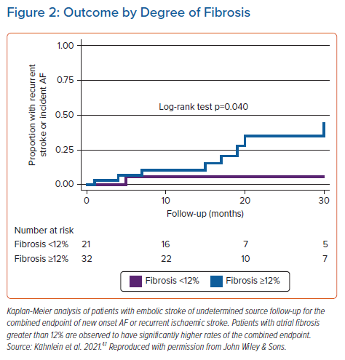
Mahnkopf C, Kwon Y, Akoum N
Outcome by Degree of Fibrosis
Citation: Arrhythmia & Electrophysiology Review 2021;10(4):225–9.
https://doi.org/10.15420/aer.2021.51

