Slide 1
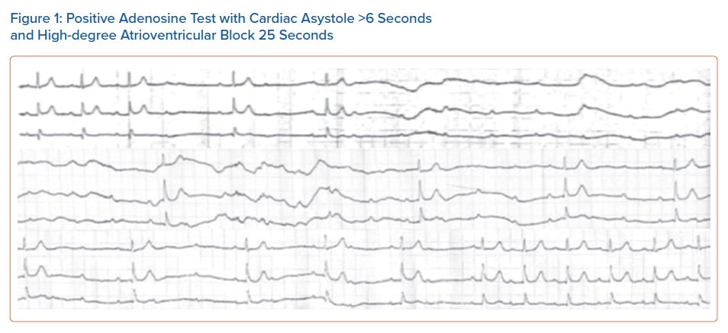
Sotiriadou M, Antoniadis AP, Fragakis N, Vassilikos V
Positive Adenosine Test with Cardiac Asystole >6 Seconds and High-degree Atrioventricular Block 25 Seconds
Citation: Arrhythmia & Electrophysiology Review 2021;10(4):230–4.
https://doi.org/10.15420/aer.2021.39

