Slide 1
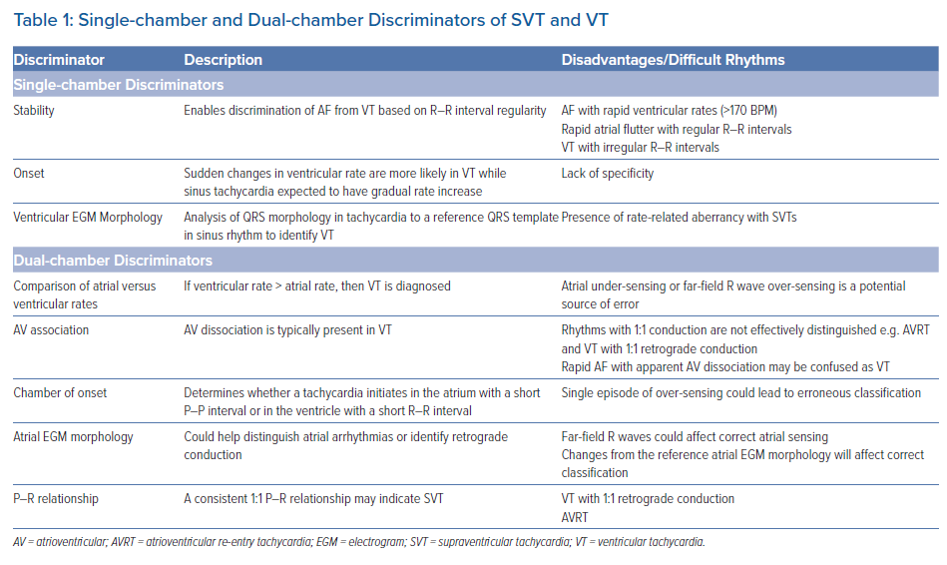
Mukherjee RK, Sohal M, Shanmugam N, Pearse SG, Jouhra F
Single-chamber and Dual-chamber Discriminators of SVT and VT
Citation: Arrhythmia & Electrophysiology Review 2021;10(4):235–40.
https://doi.org/10.15420/aer.2021.54

