Slide 1
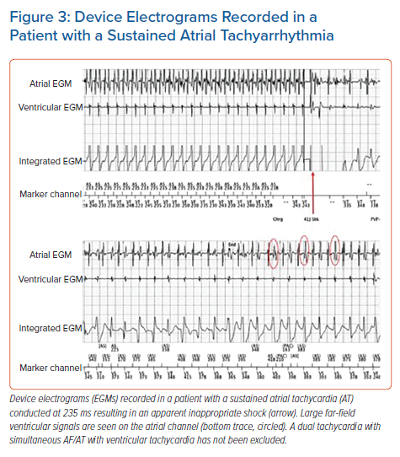
Mukherjee RK, Sohal M, Shanmugam N, Pearse SG, Jouhra F
Device Electrograms Recorded in a Patient with a Sustained Atrial Tachyarrhythmia
Citation: Arrhythmia & Electrophysiology Review 2021;10(4):235–40.
https://doi.org/10.15420/aer.2021.54

