Slide 1

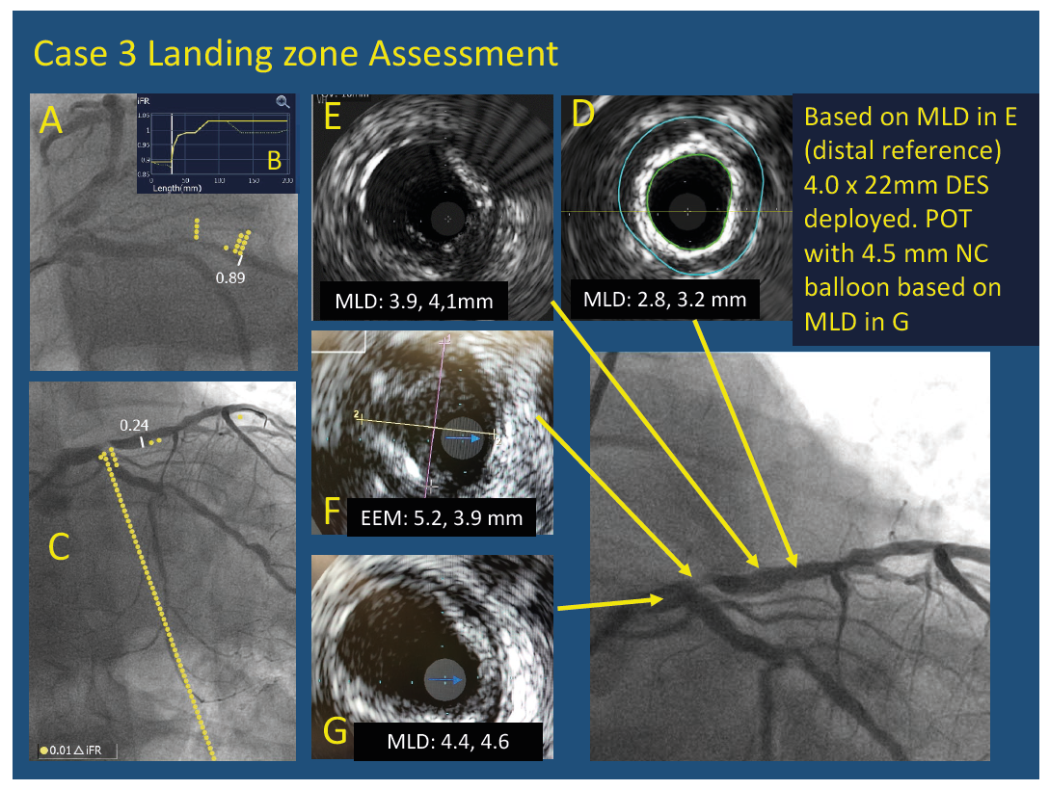
Dingli P, Gonzalo N, Escaned J
Intravascular Ultrasound-guided Management of Diffuse Stenosis
Citation: Radcliffe Cardiology 2018:1–18.
https://doi.org/10.15420/rc.2018.m005

