Slide 1
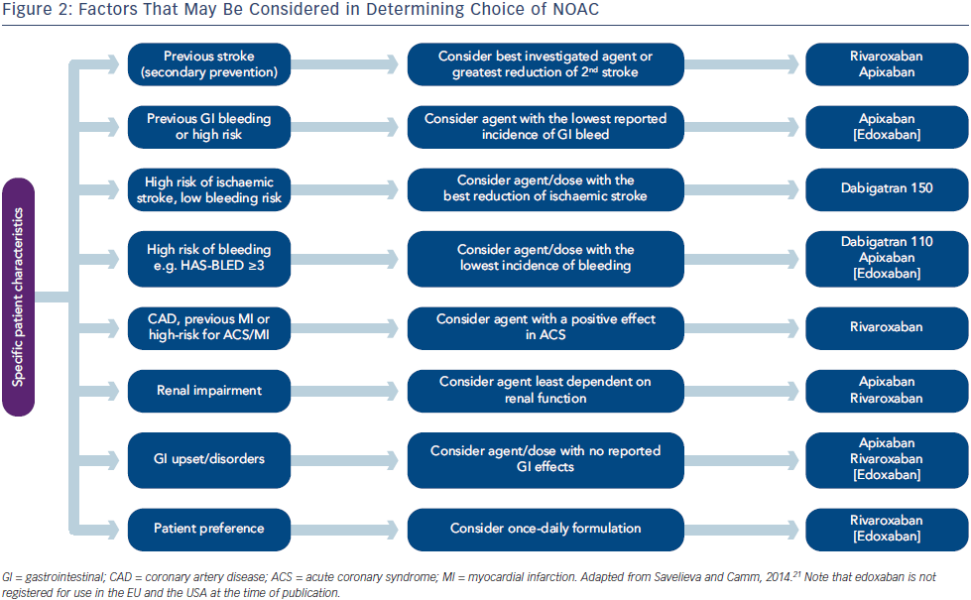
Mountfort K, Camm AJ, Lip GY, Goette A, Le Heuzey JY
Stroke Prevention in Atrial Fibrillation – Outcomes and Future Directions
Citation: Arrhythmia & Electrophysiology Review 2014;3(3):194–200
https://doi.org/10.15420/aer.2014.3.3.194

