Slide 1
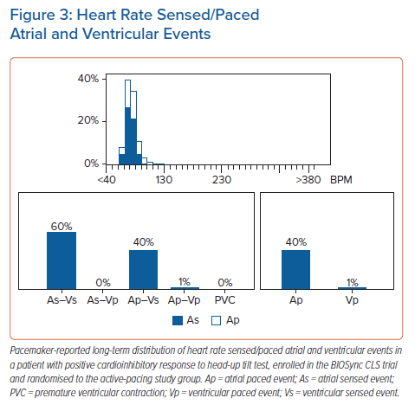
Tomaino M, Russo V, Giacopelli D, Gargaro A, Brignole M
Heart Rate Sensed/Paced Atrial and Ventricular Events
Citation: Arrhythmia & Electrophysiology Review 2021;10(4):244–9.
https://doi.org/10.15420/aer.2021.45

