Slide 1
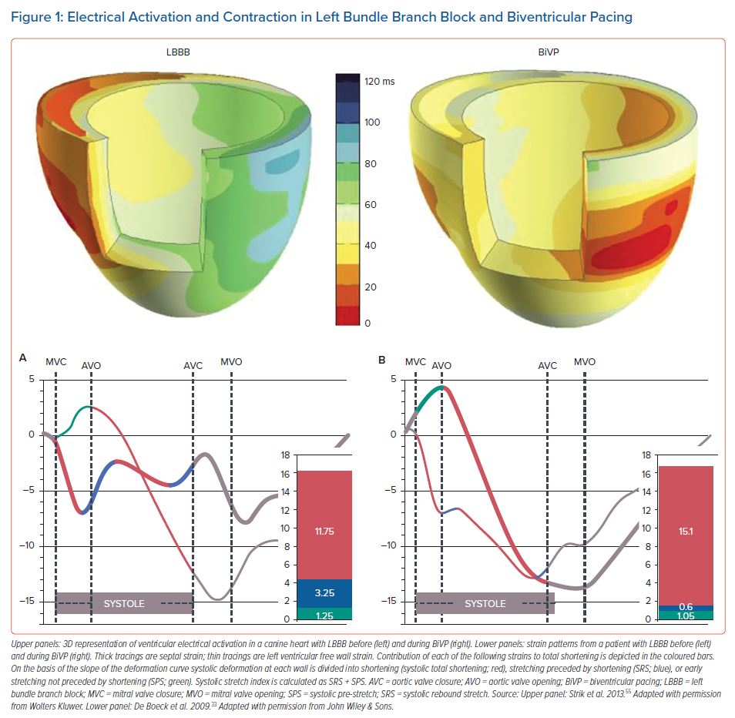
Prinzen F, Lumens J, Duchenne J, Vernooy K
Electrical Activation and Contraction in Left Bundle Branch Block and Biventricular Pacing
Citation: Arrhythmia & Electrophysiology Review 2021;10(4):250–7.
https://doi.org/10.15420/aer.2021.30

