Slide 1
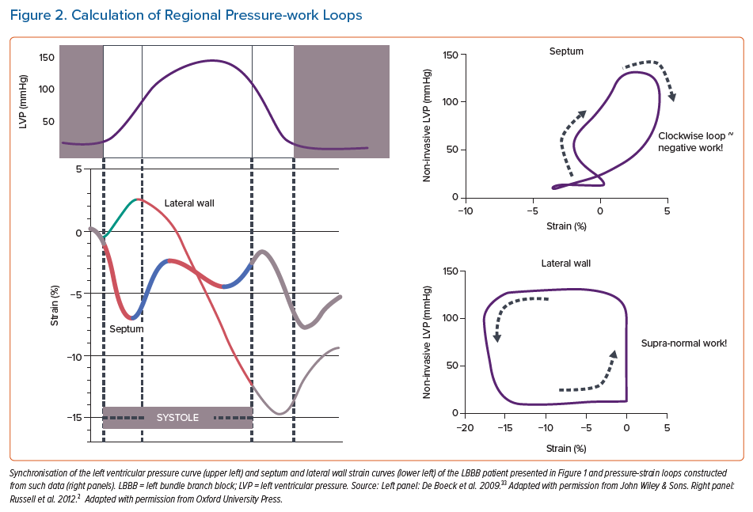
Prinzen F, Lumens J, Duchenne J, Vernooy K
Calculation of Regional Pressure-work Loops
Citation: Arrhythmia & Electrophysiology Review 2021;10(4):250–7.
https://doi.org/10.15420/aer.2021.30

