Slide 1
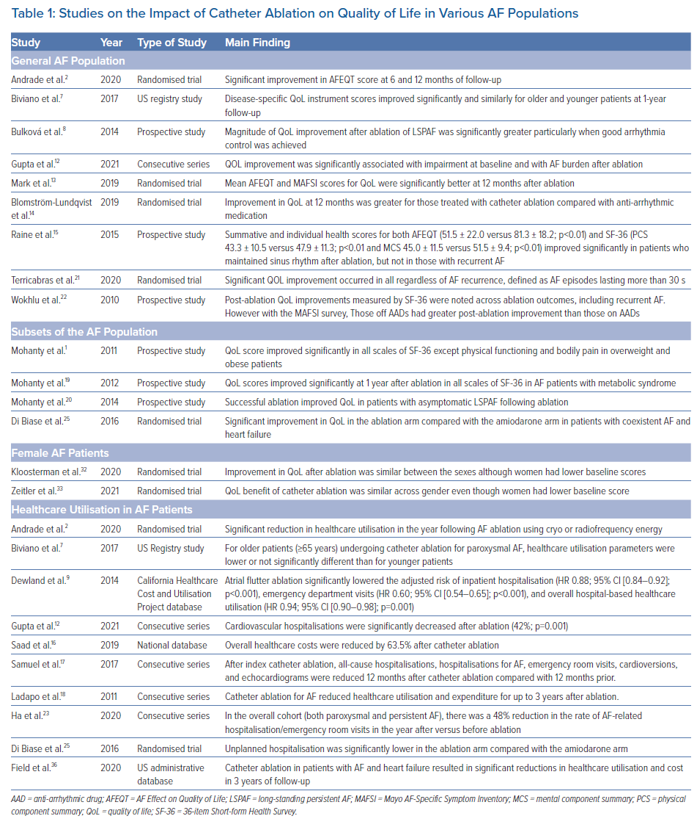
Mohanty S, Natale A
Studies on the Impact of Catheter Ablation on Quality of Life in Various AF Populations
Citation: Arrhythmia & Electrophysiology Review 2021;10(4):258–61.
https://doi.org/10.15420/aer.2021.50

