Slide 1
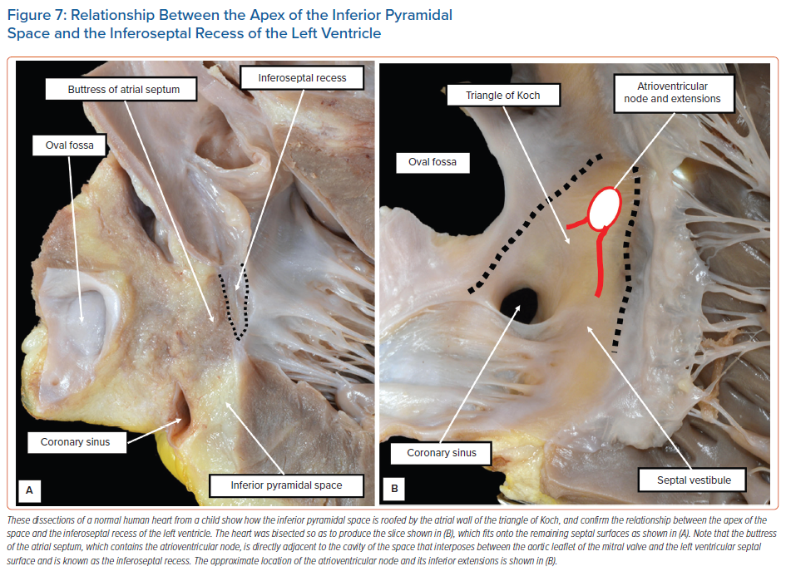
Anderson RH, Hikspoors JP, Tretter JT, Macías Y, Spicer DE, Lamers WH, Sánchez-Quintana D, Back Sternick E
Relationship Between the Apex of the Inferior Pyramidal Space and the Inferoseptal Recess of the Left Ventricle
Citation: Arrhythmia & Electrophysiology Review 2021;10(4):262–72.
https://doi.org/10.15420/aer.2021.43

