Slide 1
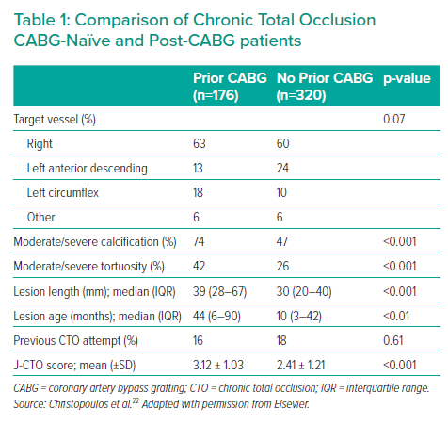
Rahman MS, de Winter R, Nap A, Knaapen P
Comparison of Chronic Total Occlusion CABG-Naïve and Post-CABG patients
Citation: Interventional Cardiology 2021;16:e33.
https://doi.org/10.15420/icr.2021.12

