Slide 1
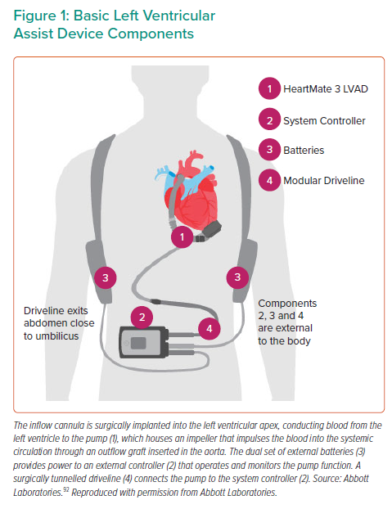
Gonzalez J, Callan P
Basic Left Ventricular Assist Device Components
Citation: Interventional Cardiology 2021;16:e34.
https://doi.org/10.15420/icr.2021.13

