Slide 1

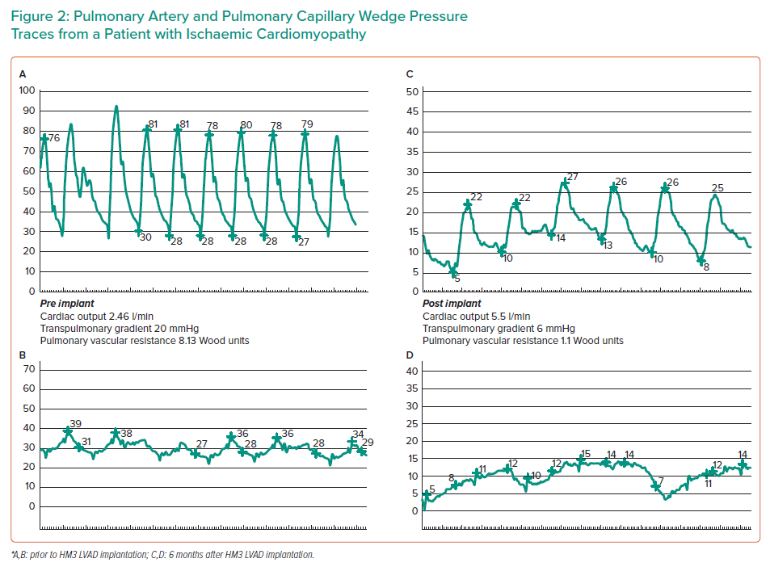
Gonzalez J, Callan P
Pulmonary Artery and Pulmonary Capillary Wedge Pressure Traces from a Patient with Ischaemic Cardiomyopathy
Citation: Interventional Cardiology 2021;16:e34.
https://doi.org/10.15420/icr.2021.13

