Slide 1
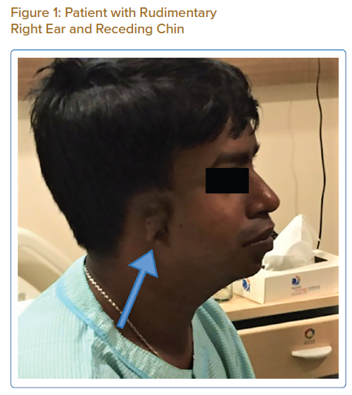
Paul A, Ghose A, Banerjee D, Banerjee S
Patient with Rudimentary Right Ear and Receding Chin
Citation: Journal of Asian Pacific Society of Cardiology 2022;1:e02.
https://doi.org/10.15420/japsc.2021.06

