Slide 1
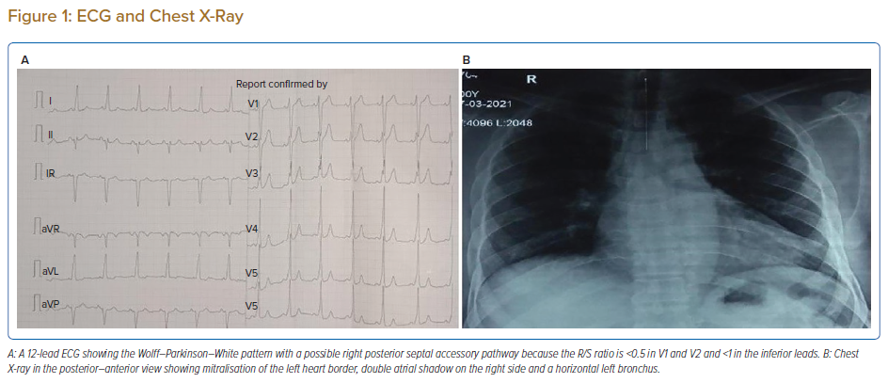
Singh J, Mahanta D, Mahapatra RP, Acharya D, Barik R
ECG and Chest X-Ray
Citation: Journal of Asian Pacific Society of Cardiology 2022;1:e03.
https://doi.org/10.15420/japsc.2021.07

