Slide 1
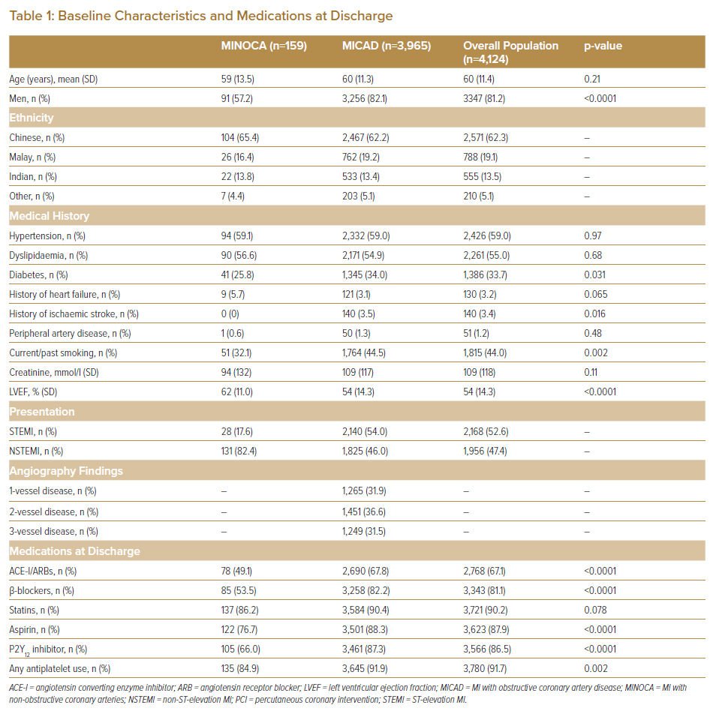
Wong CJ, Yap JJL, Gao F, Lau YH, Huang W, Jaufeerally F, Tan NC, Ho HH, Chan M, Tan KB, Yeo KK
Baseline Characteristics and Medications at Discharge
Citation: Journal of Asian Pacific Society of Cardiology 2022;1:e04.
https://doi.org/10.15420/japsc.2021.04

