Slide 1
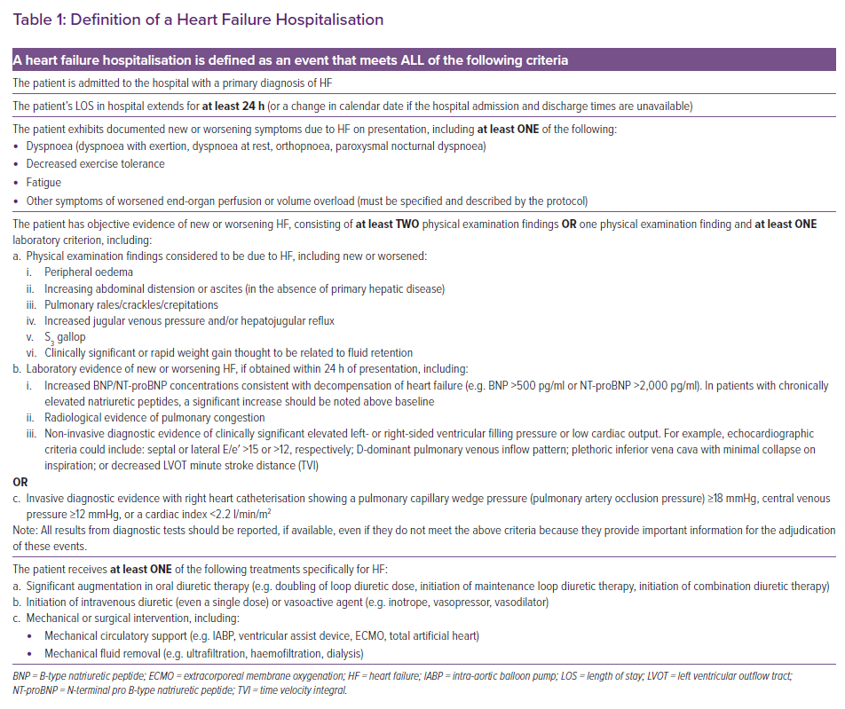
Hussain A, Misra A, Bozkurt B
Definition of a Heart Failure Hospitalisation
Citation: Cardiac Failure Review 2022;8:e01.
https://doi.org/10.15420/cfr.2021.13

