Slide 1

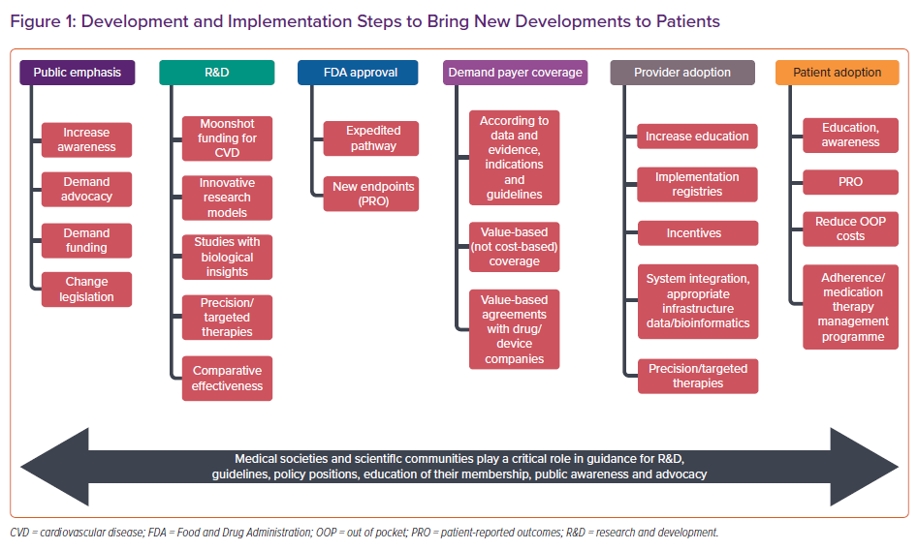
Hussain A, Misra A, Bozkurt B
Development and Implementation Steps to Bring New Developments to Patients
Citation: Cardiac Failure Review 2022;8:e01.
https://doi.org/10.15420/cfr.2021.13

