Slide 1
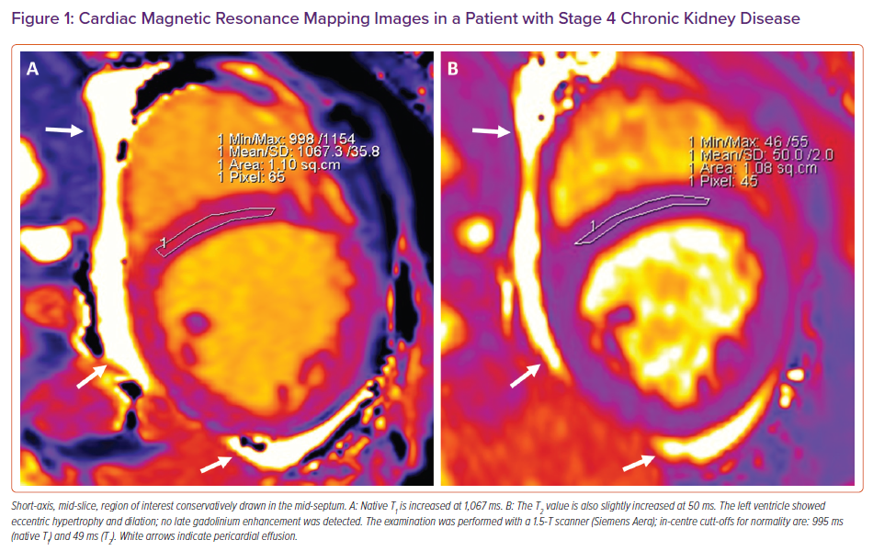
Arcari L, Camastra G, Ciolina F, Danti M, Cacciotti L
Cardiac Magnetic Resonance Mapping Images in a Patient with Stage 4 Chronic Kidney Disease
Citation: Cardiac Failure Review 2022;8:e02.
https://doi.org/10.15420/cfr.2021.19

