Slide 1
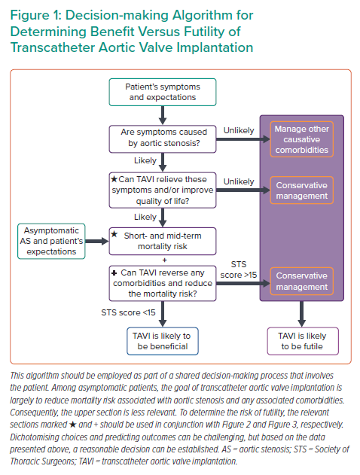
Patel KP, Treibel T, Scully P, Fertleman M, Searle S, Davis D, Moon JC, Mullen MJ
Decision-making Algorithm for Determining Benefit Versus Futility of Transcatheter Aortic Valve Implantation
Citation: Interventional Cardiology 2022;17:e01.
https://doi.org/10.15420/icr.2021.15

