Slide 1
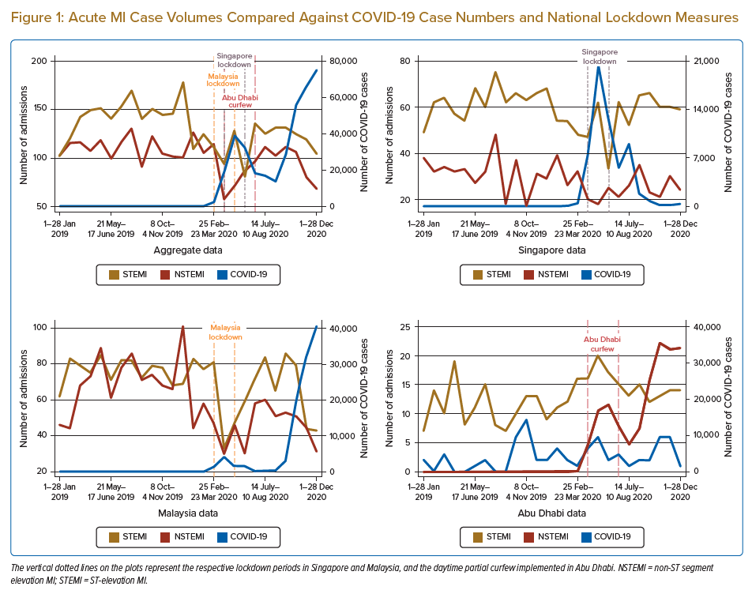
Wen Tern PJ, Jiang Y, Lau YH, Almahmeed W, Selvaraj SG, Tan JW, Wan Ahmad WA, Yap JJL, Yeo KK
Acute MI Case Volumes Compared Against COVID-19 Case Numbers and National Lockdown Measures
Citation: Journal of Asian Pacific Society of Cardiology 2022;1:e05.
https://doi.org/10.15420/japsc.2021.12

