Slide 1
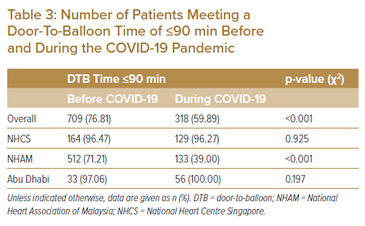
Wen Tern PJ, Jiang Y, Lau YH, Almahmeed W, Selvaraj SG, Tan JW, Wan Ahmad WA, Yap JJL, Yeo KK
Number of Patients Meeting a Door-To-Balloon Time of ≤90 min Before and During the COVID-19 Pandemic
Citation: Journal of Asian Pacific Society of Cardiology 2022;1:e05.
https://doi.org/10.15420/japsc.2021.12

