Slide 1
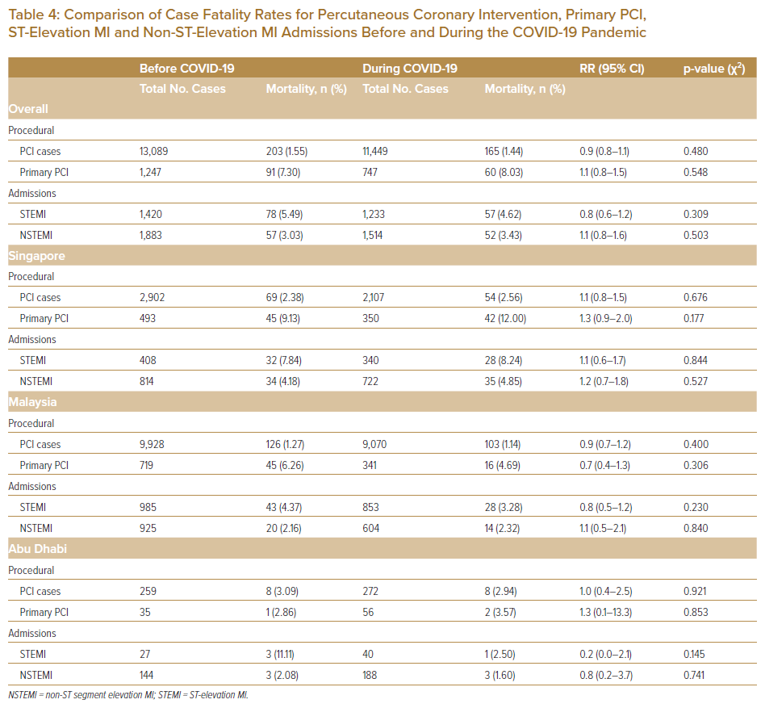
Wen Tern PJ, Jiang Y, Lau YH, Almahmeed W, Selvaraj SG, Tan JW, Wan Ahmad WA, Yap JJL, Yeo KK
Comparison of Case Fatality Rates for Percutaneous Coronary Intervention, Primary PCI, ST-Elevation MI and Non-ST-Elevation MI Admissions Before and During the COVID-19 Pandemic
Citation: Journal of Asian Pacific Society of Cardiology 2022;1:e05.
https://doi.org/10.15420/japsc.2021.12

