Slide 1
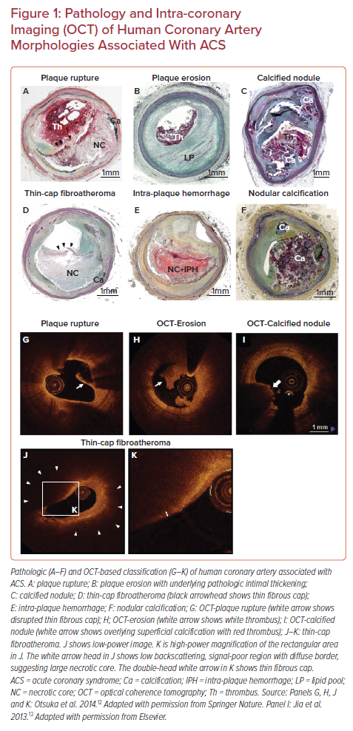
Sakamoto A, Cornelissen A, Sato Y, Mori M, Kawakami R, Kawai K, Ghosh SKB, Xu W, Abebe BG, Dikongue A, Kolodgie FD, Virmani R, Finn AV
Pathology and Intra-coronary Imaging (OCT) of Human Coronary Artery Morphologies Associated With ACS
Citation: US Cardiology Review 2022;16:e01.
https://doi.org/10.15420/usc.2021.22

