Slide 1
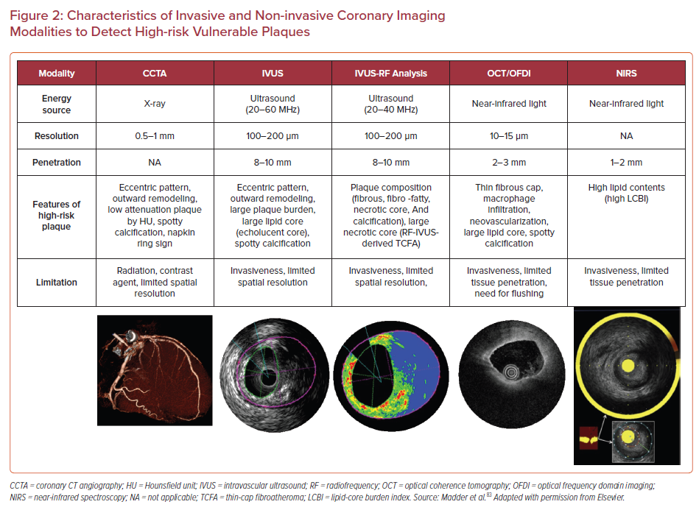
Sakamoto A, Cornelissen A, Sato Y, Mori M, Kawakami R, Kawai K, Ghosh SKB, Xu W, Abebe BG, Dikongue A, Kolodgie FD, Virmani R, Finn AV
Characteristics of Invasive and Non-invasive Coronary Imaging Modalities to Detect High-risk Vulnerable Plaques
Citation: US Cardiology Review 2022;16:e01.
https://doi.org/10.15420/usc.2021.22

