Slide 1
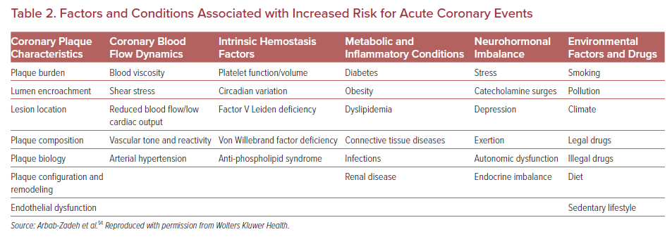
Sakamoto A, Cornelissen A, Sato Y, Mori M, Kawakami R, Kawai K, Ghosh SKB, Xu W, Abebe BG, Dikongue A, Kolodgie FD, Virmani R, Finn AV
Factors and Conditions Associated with Increased Risk for Acute Coronary Events
Citation: US Cardiology Review 2022;16:e01.
https://doi.org/10.15420/usc.2021.22

