Slide 1
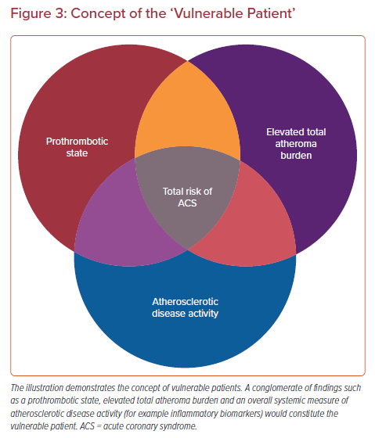
Sakamoto A, Cornelissen A, Sato Y, Mori M, Kawakami R, Kawai K, Ghosh SKB, Xu W, Abebe BG, Dikongue A, Kolodgie FD, Virmani R, Finn AV
Concept of the ‘Vulnerable Patient’
Citation: US Cardiology Review 2022;16:e01.
https://doi.org/10.15420/usc.2021.22

