Slide 1
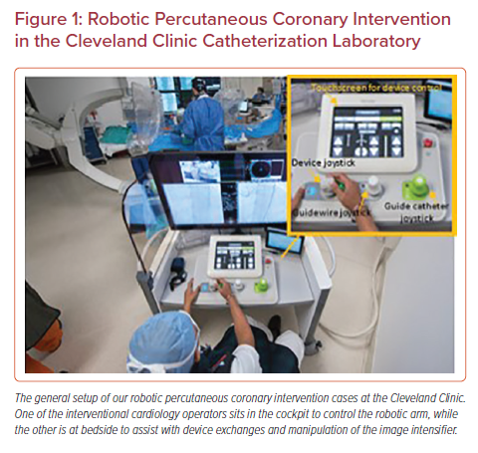
Young L, Khatri J
Robotic Percutaneous Coronary Intervention in the Cleveland Clinic Catheterization Laboratory
Citation: US Cardiology Review 2022;16:e02.
https://doi.org/10.15420/usc.2020.28R1

