Slide 1
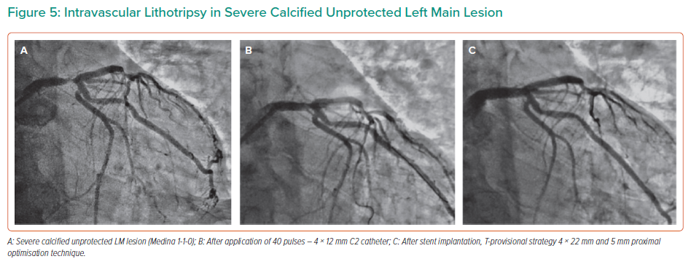
Honton B, Monsegu J
Intravascular Lithotripsy in Severe Calcified Unprotected Left Main Lesion
Citation: Interventional Cardiology 2022;17:e02.
https://doi.org/10.15420/icr.2021.14

