Slide 1

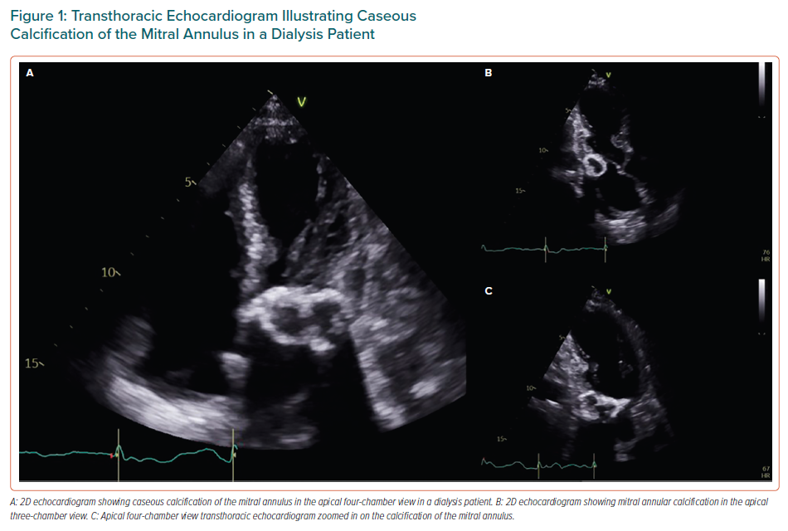
Kipourou K, O’Driscoll JM, Sharma R
Transthoracic Echocardiogram Illustrating Caseous Calcification of the Mitral Annulus in a Dialysis Patient
Citation: European Cardiology Review 2022;17:e02
https://doi.org/10.15420/ecr.2021.25

