Slide 1
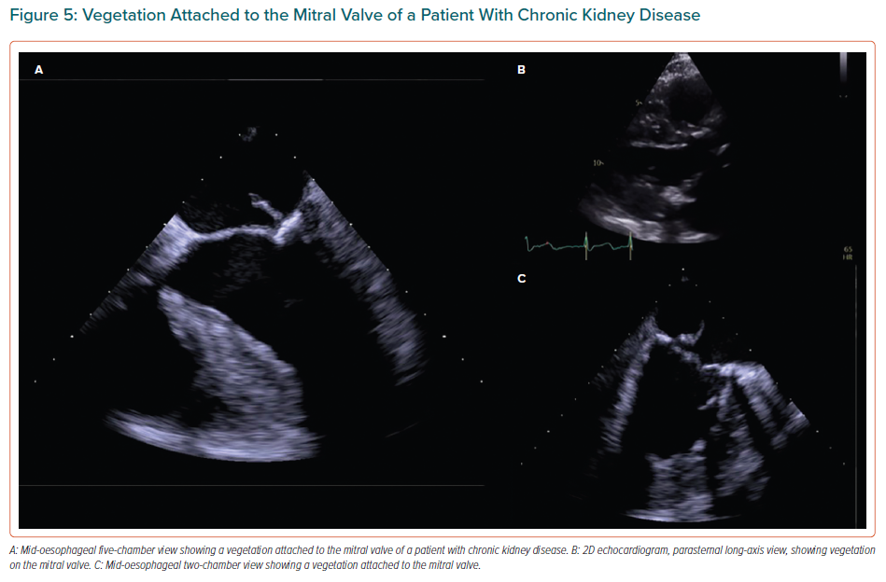
Kipourou K, O’Driscoll JM, Sharma R
Vegetation Attached to the Mitral Valve of a Patient With Chronic Kidney Disease
Citation: European Cardiology Review 2022;17:e02
https://doi.org/10.15420/ecr.2021.25

