Slide 1
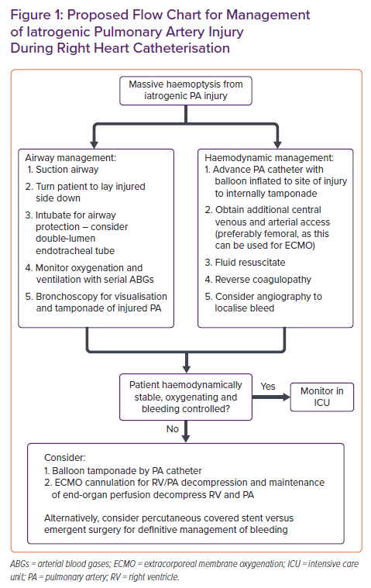
Agrawal V, Costopoulos KA, Chowdhary M, Balsara K, Schlendorf KH, Lindenfeld J, Menachem JN
Proposed Flow Chart for Management of Iatrogenic Pulmonary Artery Injury During Right Heart Catheterisation
Citation: Cardiac Failure Review 2022;8:e03.
https://doi.org/10.15420/cfr.2021.25

