Slide 1
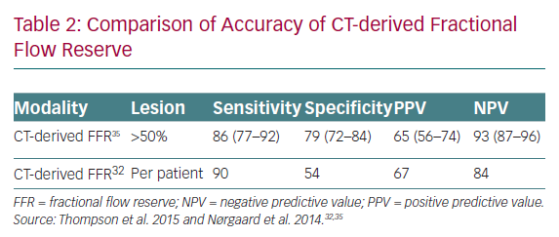
Heseltine TD, Murray SW, Ruzsics B, Fisher M
Comparison of Accuracy of CT-derived Fractional Flow Reserve
Citation: European Cardiology Review 2020;15:e01.
https://doi.org/10.15420/ecr.2019.14.2

