Slide 1
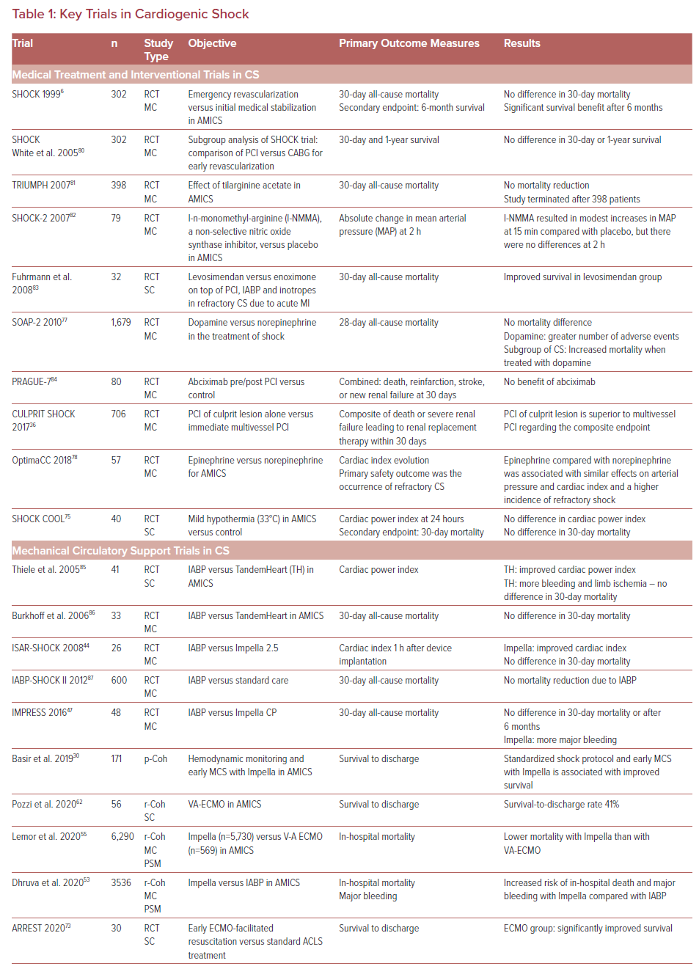
Ott S, Leser L, Lanmüller P, Just IA, Leistner D, Potapov E, O’Brien B, Klages J
Key Trials in Cardiogenic Shock
Citation: US Cardiology Review 2022;16:e03.
https://doi.org/10.15420/usc.2021.25

