Slide 1
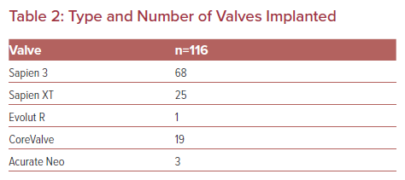
Alasnag M, Ahmed W, Al-Nasser I, Al-Shaibi K
Type and Number of Valves Implanted
Citation: US Cardiology Review 2022;16:e04.
https://doi.org/10.15420/usc.2021.07

