Slide 1
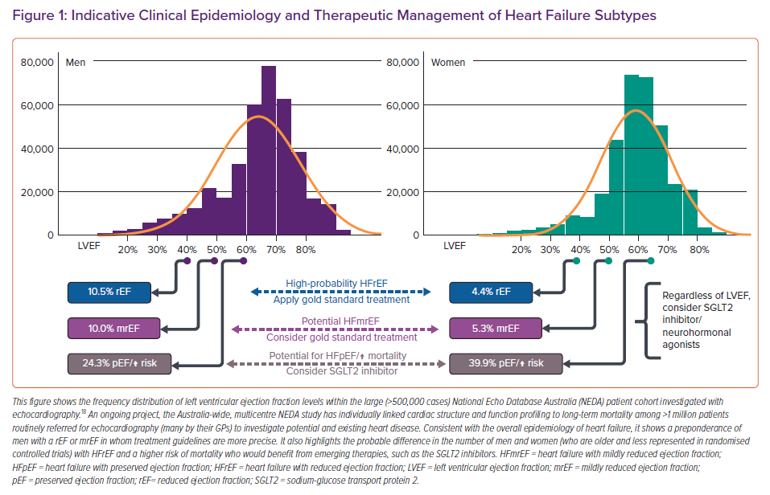
Stewart S, Stewart AR, Waite L, Beilby J
Indicative Clinical Epidemiology and Therapeutic Management of Heart Failure Subtypes
Citation: Cardiac Failure Review 2022;8:e04.
https://doi.org/10.15420/cfr.2021.27

