Slide 1
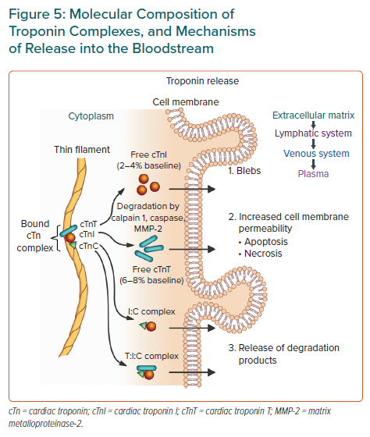
Rafiudeen R, Barlis P, White HD, van Gaal W
Molecular Composition of Troponin Complexes, and Mechanisms of Release into the Bloodstream
Citation: European Cardiology Review 2022;17:e03.
https://doi.org/10.15420/ecr.2021.42

