Slide 1

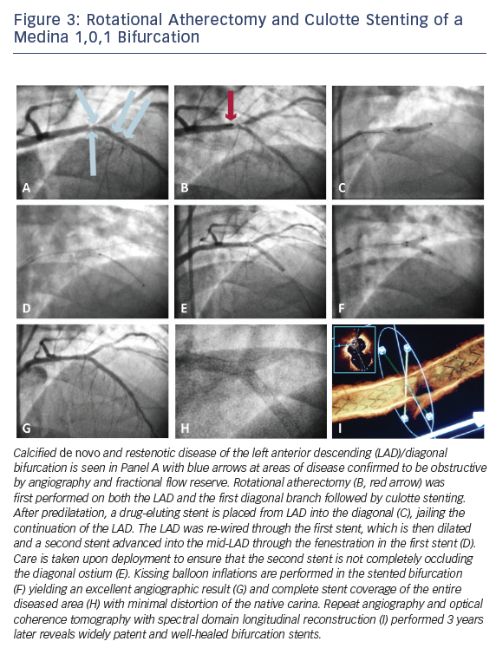
Estrada JR, Paul JD, Shah AP, Nathan S
Overview of Technical and Cost Considerations in Complex Percutaneous Coronary Intervention
Citation: Interventional Cardiology Review 2014;9(1):17–22
https://doi.org/10.15420/icr.2011.9.1.17

